Slide 1
St. Louis Central Corridor West Building Permits
Monthly Report: November 2020

Slide 2
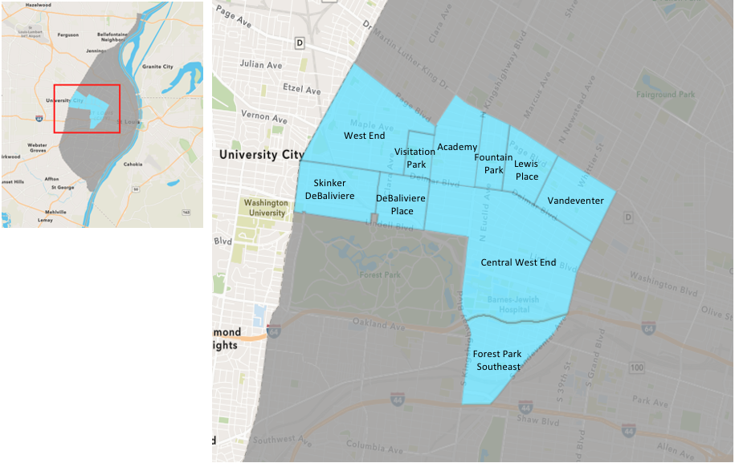
St. Louis Neighborhood Spatial Reference

Slide 3
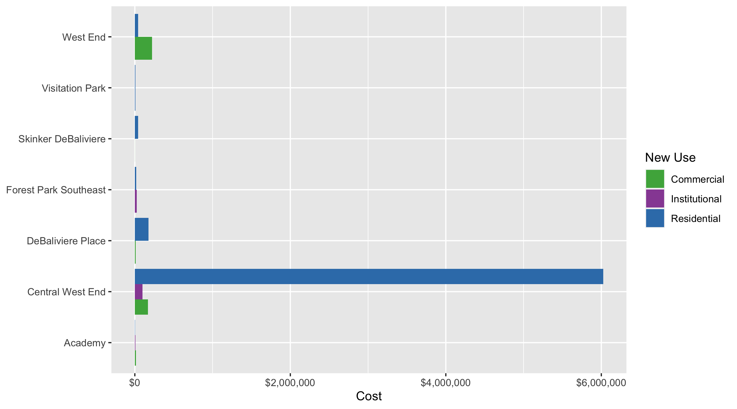
Neighborhood Summary: Average Building Permit Cost

Slide 4
Neighborhood Summary
November 2020 | November 2020 | November 2020 | November 2020
Neighborhood | Average Cost | # of Permits | Total Value of Permits
Academy | $4,644 | 7 | $32,509
Central West End | $1,801,755 | 21 | $37,836,864
DeBaliviere Place | $127,156 | 7 | $890,095
Forest Park Southeast | $19,375 | 8 | $155,000
Fountain Park | $0 | 0 | $0
Lewis Place | $0 | 0 | $0
Skinker DeBaliviere | $38,475 | 8 | $307,800
Vandeventer | $0 | 0 | $0
Visitation Park | $7,774 | 1 | $7,774
West End | $59,158 | 11 | $650,735
Last 6 Months | Last 6 Months | Last 6 Months | Last 6 Months
Neighborhood | Average Cost | # of Permits | Total Value of Permits
Academy | $18,793 | 33 | $620,169
Central West End | $592,620 | 221 | $130,969,050
DeBaliviere Place | $348,544 | 36 | $12,547,593
Forest Park Southeast | $4,175,738 | 74 | $309,004,619
Fountain Park | $75,000 | 4 | $300,000
Lewis Place | $72,251 | 11 | $794,760
Skinker DeBaliviere | $106,909 | 63 | $6,735,238
Vandeventer | $45,597 | 10 | $455,972
Visitation Park | $17,205 | 6 | $103,229
West End | $64,258 | 50 | $3,212,890

Slide 5
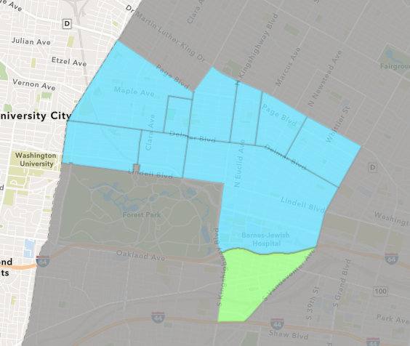
Forest Park Southeast
November 2020 Neighborhood Cost Breakdown
Mean: $19,375
Median: $11,000
Range: $1,500 - $60,000

Slide 6
Forest Park Southeast: Summary Notes
8 building permits in November 2020
-42.86% change compared to November 2019 (14 total building permits)
$19,375: Average building permit cost in November 2020
-71.09% change compared to November 2019 ($67,018)
115 total building permits in 2020
-29.88% change YTD compared to this time in 2019 (164 total building permits)
$2,704,977: YTD average building permit cost in 2020
1308.58% change YTD compared to this time in 2019 ($192,035)

Slide 7
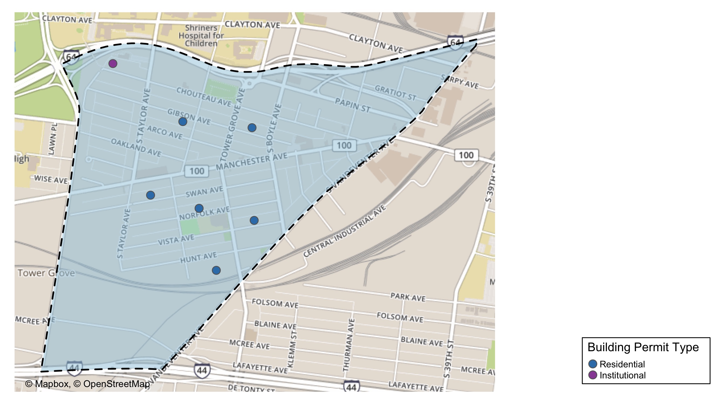
Forest Park Southeast

Slide 8
Neighborhood Summary
November 2020 | November 2020 | November 2020 | November 2020
Permit Use | Average Cost | # of Permits | Total Value of Permits
Commercial | $0 | 0 | $0
Industrial | $0 | 0 | $0
Institutional | $23,000 | 1 | $23,000
Residential | $18,857 | 7 | $132,000
Last 6 Months | Last 6 Months | Last 6 Months | Last 6 Months
Permit Use | Average Cost | # of Permits | Total Value of Permits
Commercial | $60,464 | 11 | $665,100
Industrial | $267,033 | 3 | $801,100
Institutional | $420,817 | 11 | $4,628,989
Residential | $6,181,825 | 49 | $302,909,430

Slide 9
Forest Park Southeast Individual Permit Breakdown
Owner | New Use | Cost | address
CODY, OLIVER | Residential | $1,500 | 4450 GIBSON AV
UNIFY DEVELOPMENT LLC | Residential | $10,000 | 4364 HUNT AV
JCAT HOLDINGS LLC | Institutional | $23,000 | 4501 CHOUTEAU AV
JVG PROPERTIES LLC | Residential | $2,500 | 4309 NORFOLK AV
COFFIN, SARAH & MARK F. BARNETT | Residential | $38,000 | 4308 CHOUTEAU AV
SCHRAM, LEE & STEWART | Residential | $8,000 | 1317 S BOYLE AV
JVG PROPERTIES LLC | Residential | $60,000 | 4309 NORFOLK AV
GROVE LOFTS STL LLC | Residential | $12,000 | 4440 MANCHESTER AV

Slide 10
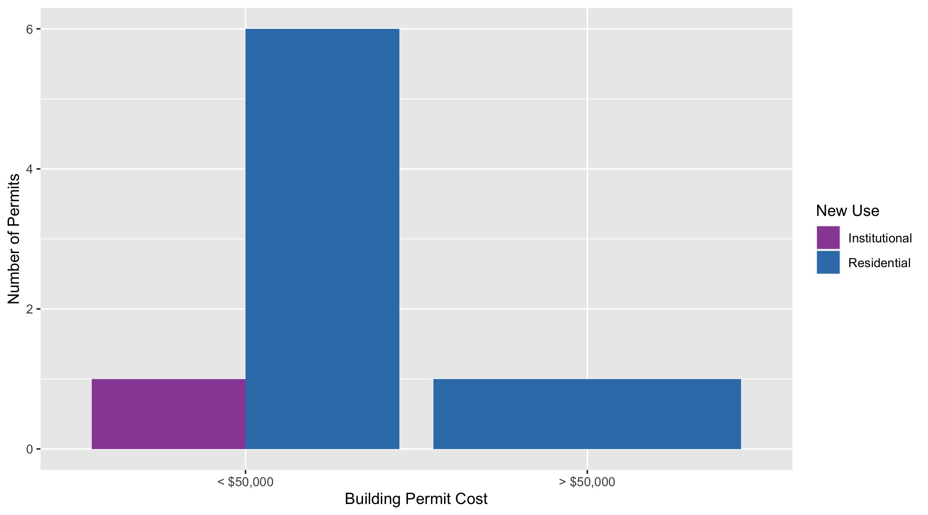
Forest Park Southeast Permit Cost Breakdown

Slide 11
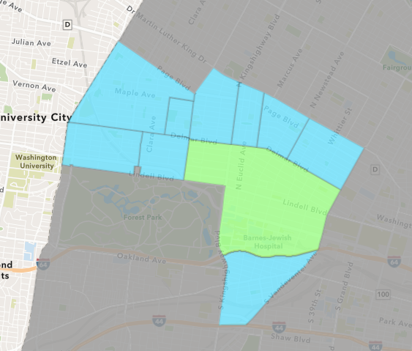
Central West End
November 2020 Neighborhood Cost Breakdown
Mean: $1,801,755
Median: $15,000
Range: $350 - $36,000,000

Slide 12
Central West End: Summary Notes
21 building permits in November 2020
-52.27% change compared to November 2019 (44 total building permits)
$1,801,755: Average building permit cost in November 2020
623.50% change compared to November 2019 ($249,032)
390 total building permits in 2020
-13.33% change YTD compared to this time in 2019 (450 total building permits)
$443,685: YTD average building permit cost in 2020
94.42% change YTD compared to this time in 2019 ($228,211)

Slide 13
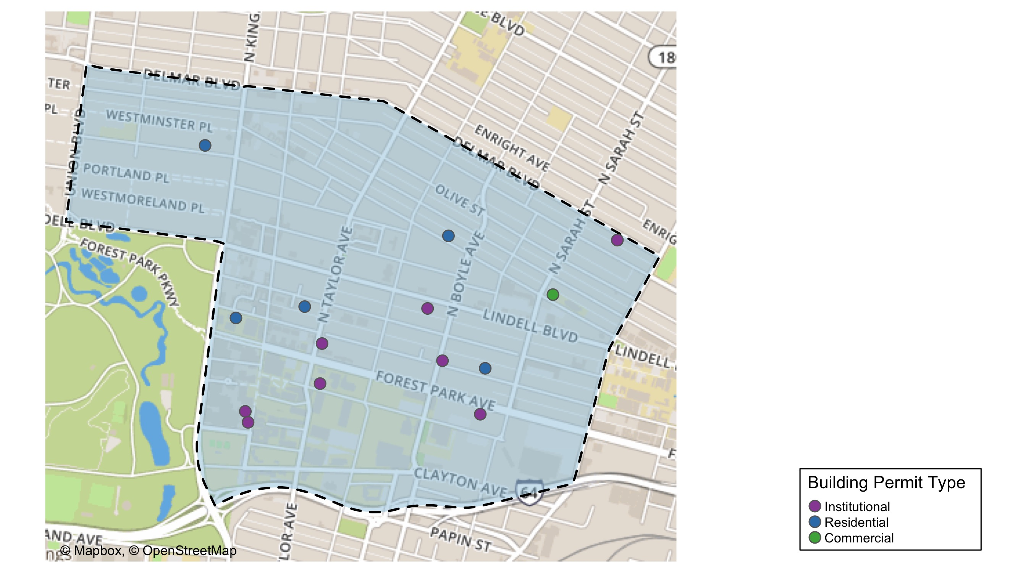
Central West End

Slide 14
Central West End
November 2020 | November 2020 | November 2020 | November 2020
Permit Use | Average Cost | # of Permits | Total Value of Permits
Commercial | $167,233 | 3 | $501,700
Industrial | $0 | 0 | $0
Institutional | $99,472 | 12 | $1,193,664
Residential | $6,023,583 | 6 | $36,141,500
Last 6 Months | Last 6 Months | Last 6 Months | Last 6 Months
Permit Use | Average Cost | # of Permits | Total Value of Permits
Commercial | $89,266 | 33 | $2,945,776
Industrial | $0 | 0 | $0
Institutional | $612,695 | 73 | $44,726,750
Residential | $724,318 | 115 | $83,296,524

Slide 15
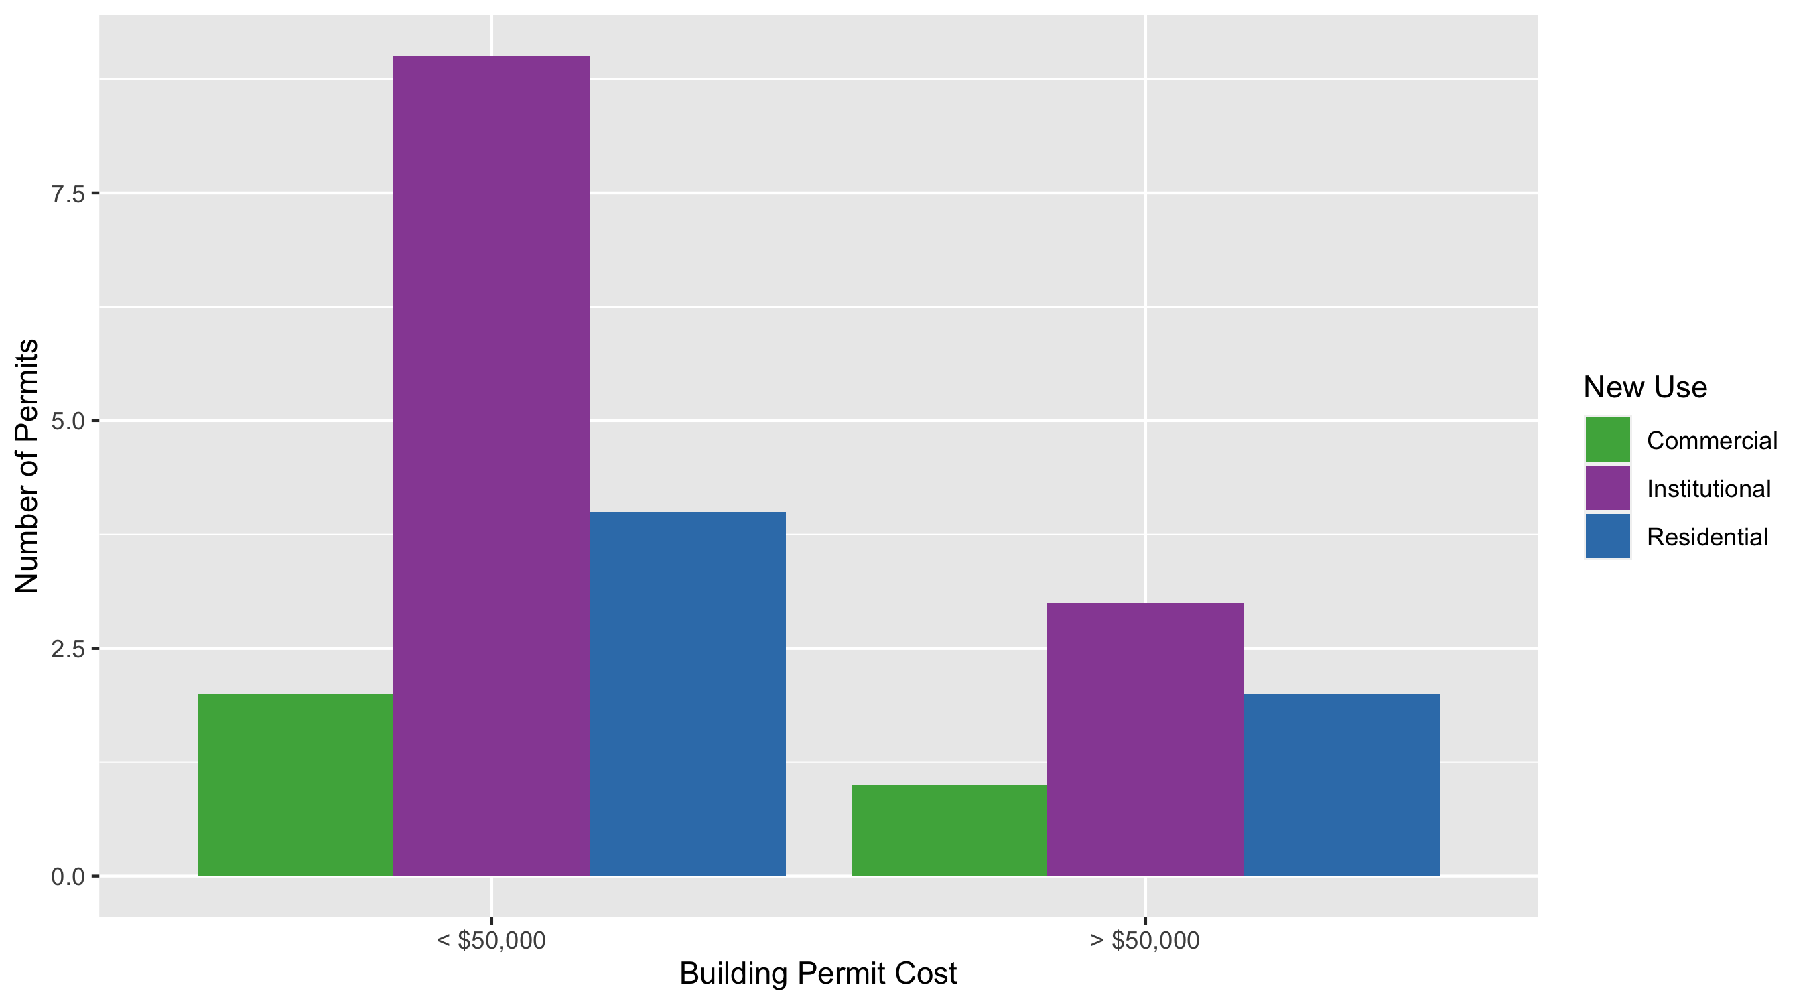
Cental West End Permit Cost Breakdown

Slide 16
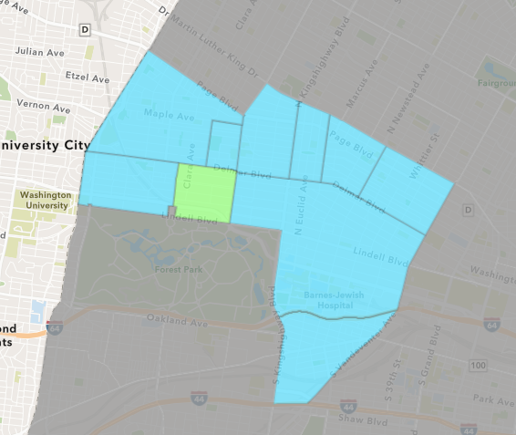
DeBaliviere Place
November 2020 Neighborhood Cost Breakdown
Mean: $127,156
Median: $69,900
Range: $3,000 - $437,500

Slide 17
DeBaliviere Place: Summary Notes
7 building permits in November 2020
75.00% change compared to November 2019 (4 total building permits)
$127,156: Average building permit cost in November 2020
788.86% change compared to November 2019 ($14,306)
55 total building permits in 2020
3.77% change YTD compared to this time in 2019 (53 total building permits)
$619,594: YTD average building permit cost in 2020
1159.90% change YTD compared to this time in 2019 ($49,178)

Slide 18
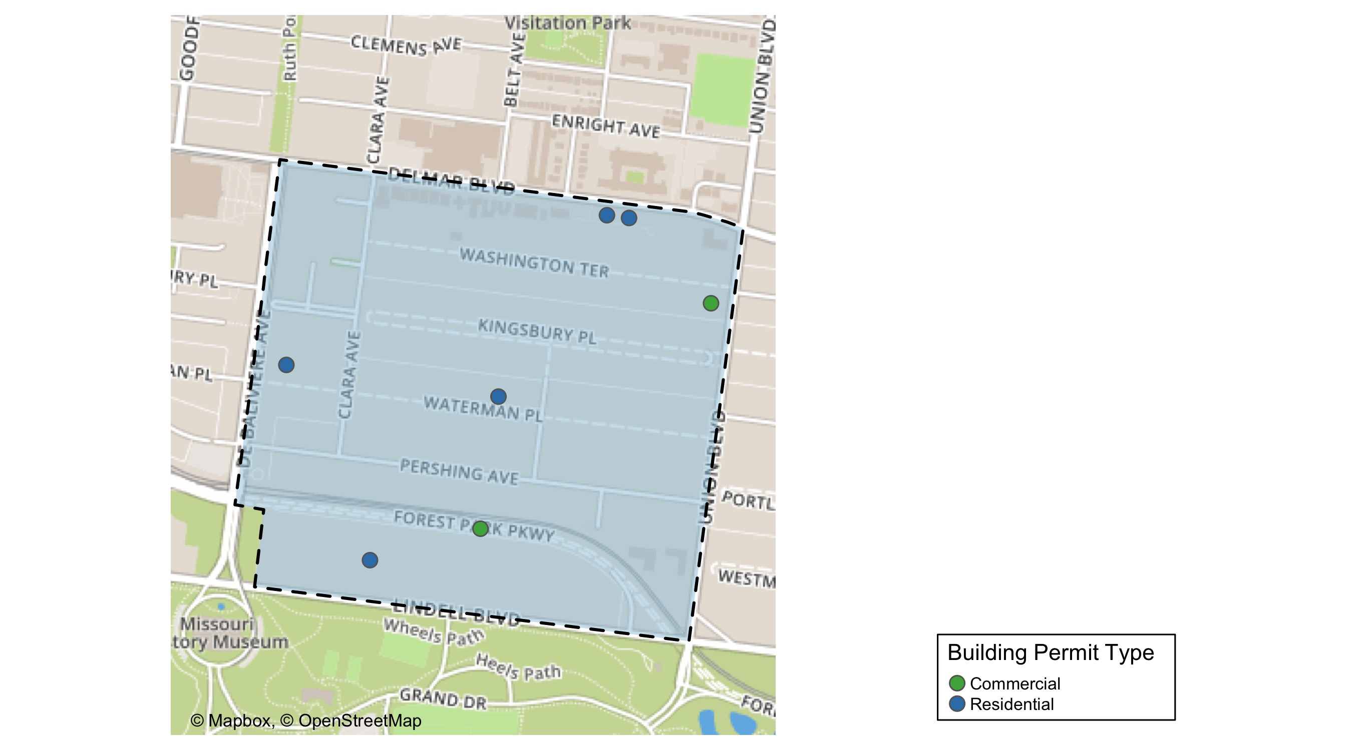
DeBaliviere Place

Slide 19
DeBaliviere Place
November 2020 | November 2020 | November 2020 | November 2020
Permit Use | Average Cost | # of Permits | Total Value of Permits
Commercial | $9,000 | 2 | $18,000
Industrial | $0 | 0 | $0
Institutional | $0 | 0 | $0
Residential | $174,419 | 5 | $872,095
Last 6 Months | Last 6 Months | Last 6 Months | Last 6 Months
Permit Use | Average Cost | # of Permits | Total Value of Permits
Commercial | $6,260 | 3 | $18,780
Industrial | $0 | 0 | $0
Institutional | $400 | 1 | $400
Residential | $391,513 | 32 | $12,528,413

Slide 20
DeBaliviere Place Individual Permit Breakdown
Owner | New Use | Cost | Address
EMERLAD CWE DE LLC & | Commercial | $15,000 | 275 UNION BLVD
WATERMAN 4 CONDOMINIUMS - PARCEL 4 | Residential | $75,994 | 5635 WATERMAN BLVD
WILLIAMS, CHRISTOPHER & BROOKE | Residential | $69,900 | 9 KINGSBURY PL
DEL CLARA APARTMENTS, LLC | Commercial | $3,000 | 5600 DELMAR BLVD
WATERMAN-KINGSBURY CONDOMINIUM | Residential | $273,701 | 5675-83 WATERMAN BLVD
GALLANT, EUGENE G JR & CHRISTINE K | Residential | $15,000 | 21 KINGSBURY PL
SHAUGHNESSY, JAMES A & KAREN L TRS | Residential | $437,500 | 5533 LINDELL BLVD

Slide 21
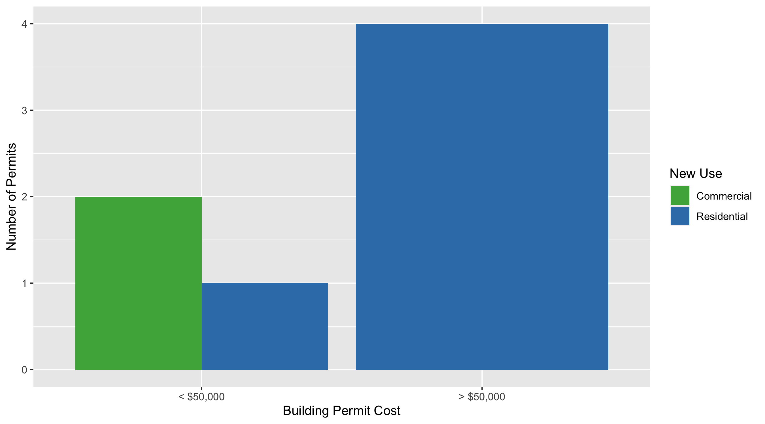
DeBaliviere Place Permit Cost Breakdown

Slide 22
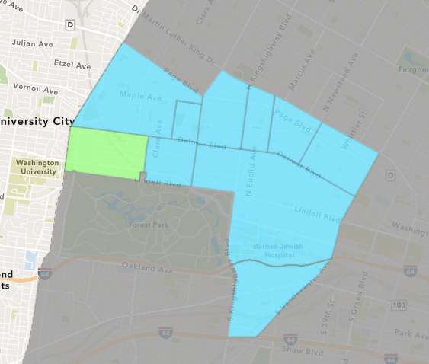
Skinker DeBaliviere
November 2020 Neighborhood Cost Breakdown
Mean: $38,475
Median: $40,000
Range: $800 - $72,000

Slide 23
Skinker DeBaliviere: Summary Notes
8 building permits in November 2020
14.29% change compared to November 2019 (7 total building permits)
$38,475: Average building permit cost in November 2020
148.42% change compared to November 2019 ($15,488)
118 total building permits in 2020
73.53% change YTD compared to this time in 2019 (68 total building permits)
$570,810: YTD average building permit cost in 2020
2733.52% change YTD compared to this time in 2019 ($20,145)

Slide 24
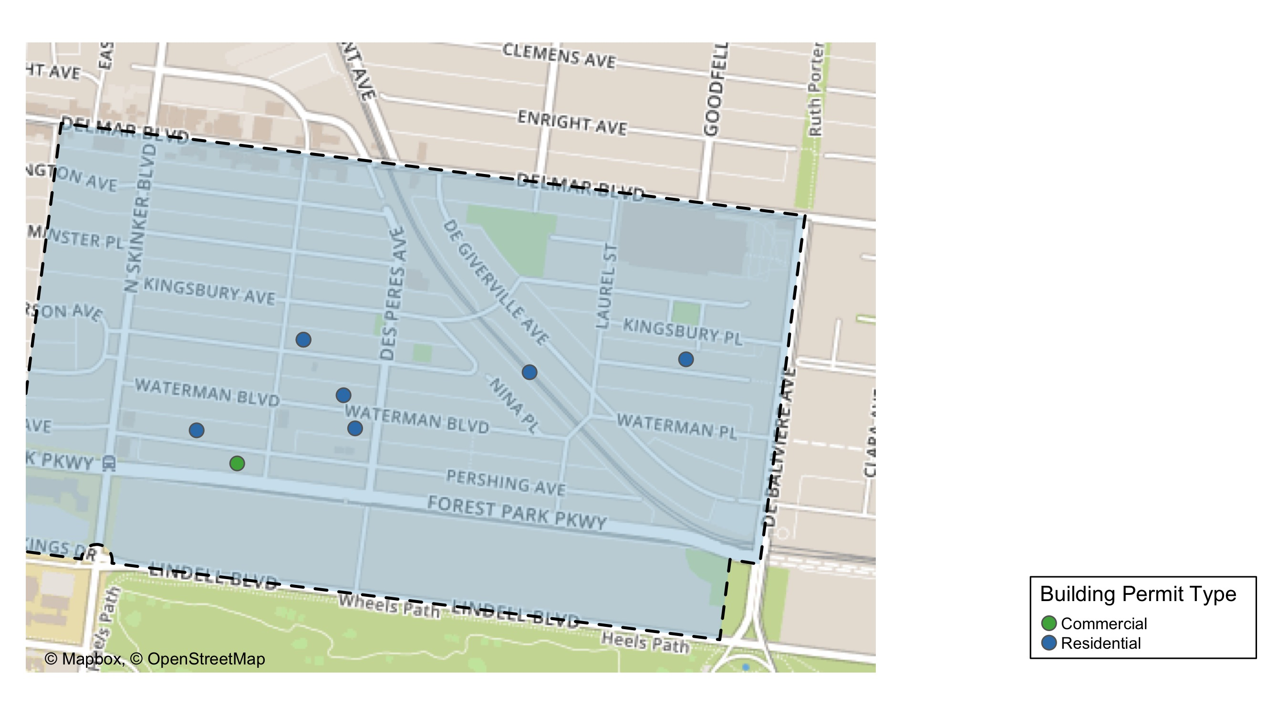
Skinker DeBaliviere

Slide 25
Skinker DeBaliviere
November 2020 | November 2020 | November 2020 | November 2020
Permit Use | Average Cost | # of Permits | Total Value of Permits
Commercial | $800 | 1 | $800
Industrial | $0 | 0 | $0
Institutional | $0 | 0 | $0
Residential | $43,857 | 7 | $307,000
Last 6 Months | Last 6 Months | Last 6 Months | Last 6 Months
Permit Use | Average Cost | # of Permits | Total Value of Permits
Commercial | $85,486 | 8 | $683,890
Industrial | $0 | 0 | $0
Institutional | $622,267 | 6 | $3,733,601
Residential | $47,301 | 49 | $2,317,747

Slide 26
Skinker DeBaliviere Individual Permit Breakdown
Owner | New Use | Cost | Address
OJEWOLA, OJETUNDE & IBUKUNOLUWA | Residential | $6,500 | 5726 KINGSBURY PL
DOLAN PL LLC | Residential | $4,500 | 6022-24 MCPHERSON AV
WASHINGTON UNIVERSITY P | Commercial | $800 | 278 N SKINKER BLVD
LADEN, SHENITHA | Residential | $55,000 | 5836 DEGIVERVILLE AV
GORMAN, MARK B | Residential | $25,000 | 6124-26 WATERMAN BLVD
THE WASHINGTON UNIVERSITY | Residential | $72,000 | 6001-05 MCPHERSON AV
WASHINGTON UNIVERSITY | Residential | $72,000 | 353 DES PERES AV
THE WASHINGTON UNIVERSITY | Residential | $72,000 | 6001 MCPHERSON AV

Slide 27
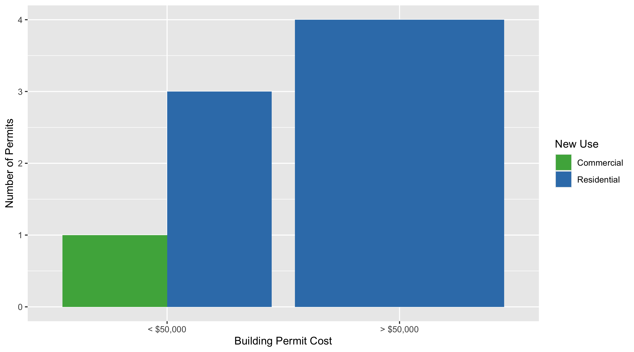
Skinker DeBaliviere Permit Cost Breakdown

Slide 28
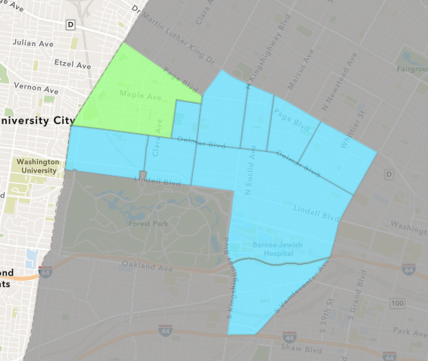
West End
November 2020 Neighborhood Cost Breakdown
Mean: $59,158
Median: $5,735
Range: $400 - $221,450

Slide 29
West End: Summary Notes
11 building permits in November 2020
120.00% change compared to November 2019 (5 total building permits)
$59,158: Average building permit cost in November 2020
-49.73% change compared to November 2019 ($117,671)
78 total building permits in 2020
65.96% change YTD compared to this time in 2019 (47 total building permits)
$313,571: YTD average building permit cost in 2020
162.28% change YTD compared to this time in 2019 ($119,558)

Slide 30
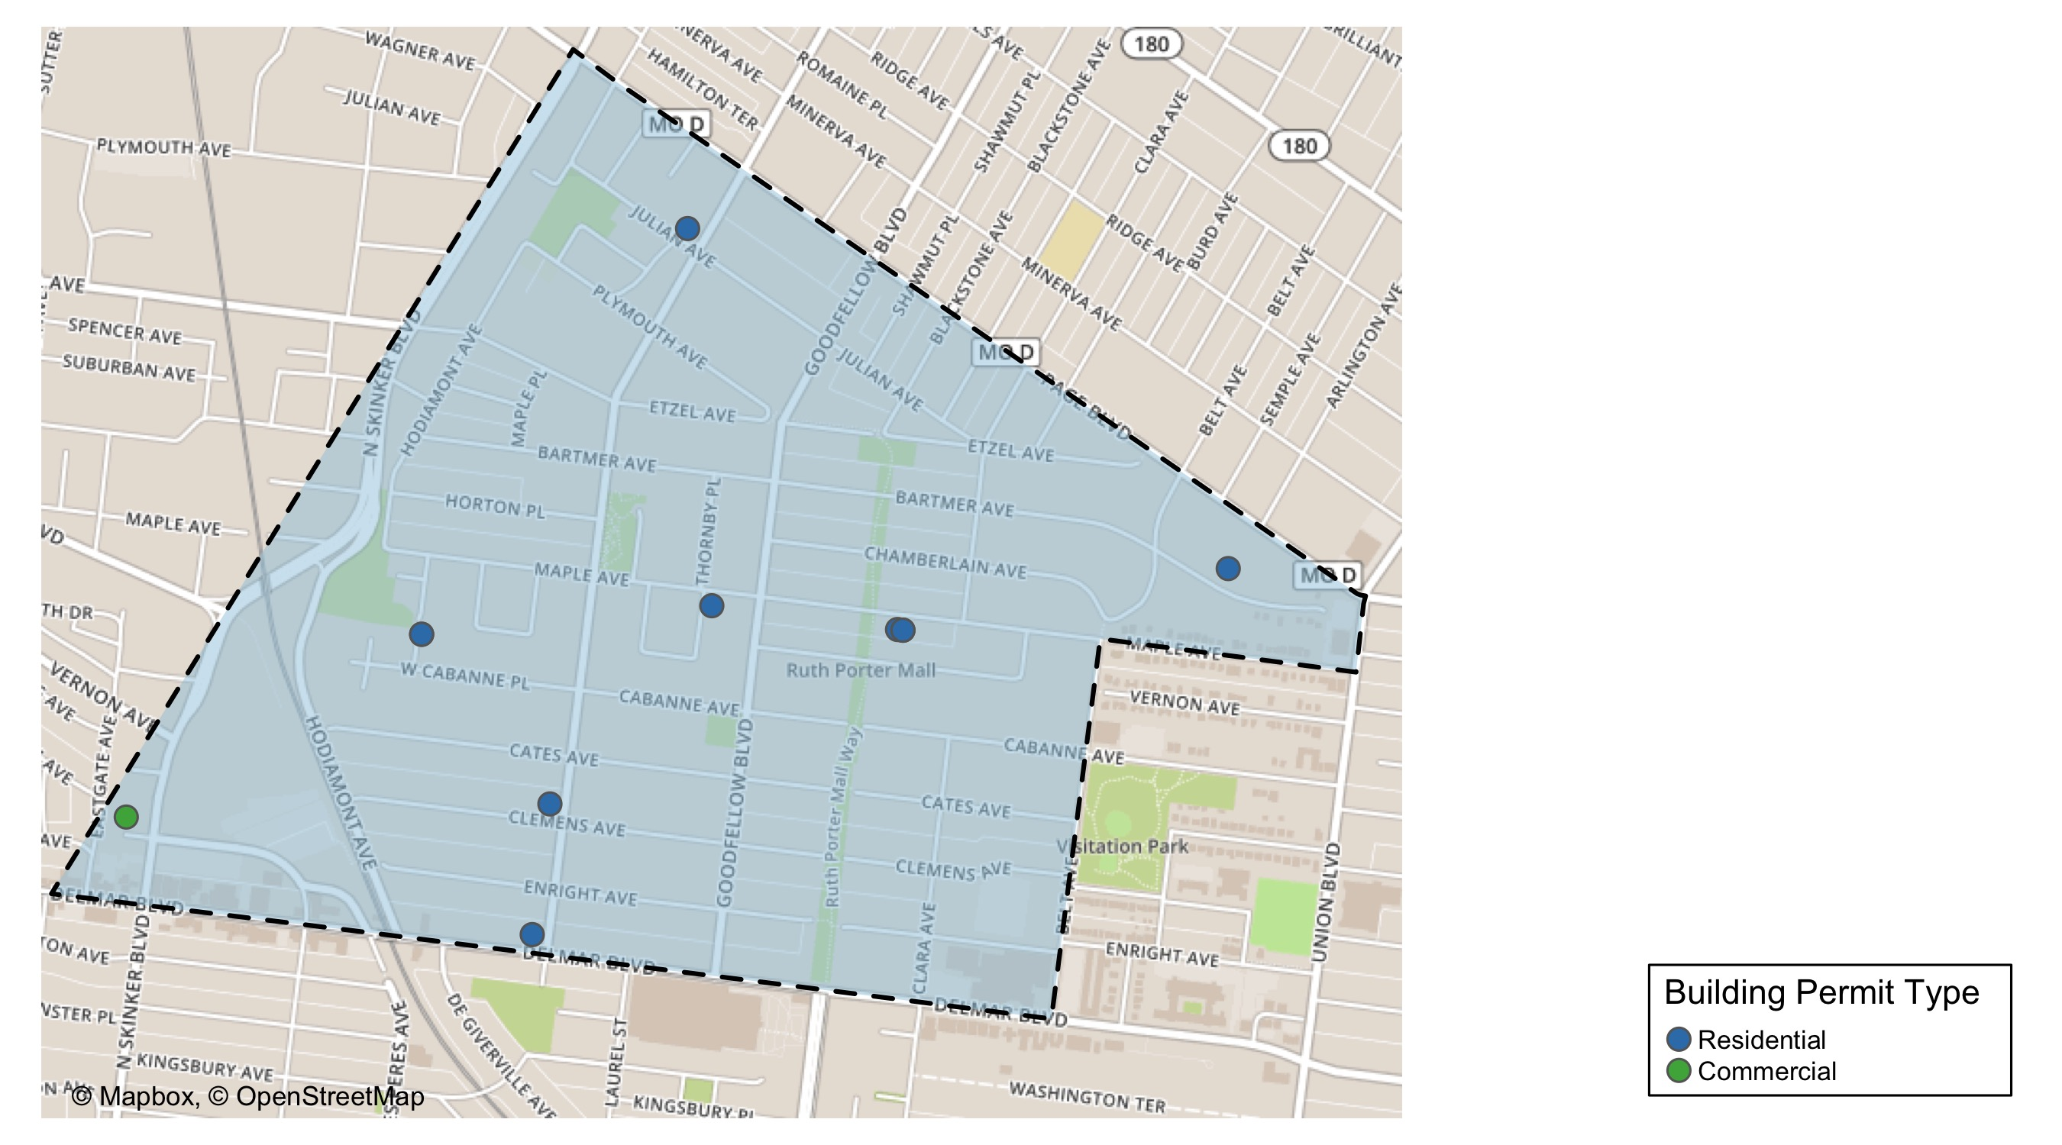
West End

Slide 31
West End
November 2020 | November 2020 | November 2020 | November 2020
Permit Use | Average Cost | # of Permits | Total Value of Permits
Commercial | $221,450 | 1 | $221,450
Industrial | $0 | 0 | $0
Institutional | $0 | 0 | $0
Residential | $42,928 | 10 | $429,285
Last 6 Months | Last 6 Months | Last 6 Months | Last 6 Months
Permit Use | Average Cost | # of Permits | Total Value of Permits
Commercial | $29,366 | 8 | $234,930
Industrial | $0 | 0 | $0
Institutional | $521,018 | 2 | $1,042,035
Residential | $48,398 | 40 | $1,935,925

Slide 32
West End Individual Permit Breakdown
Owner | New Use | Cost | Address
MORSE, CHERYL & HENRIETTA BARTLETT & | Residential | $200,000 | 5944 CATES AV
PACE DELMAR ASSOCIATES LLC | Commercial | $221,450 | 6217 DELMAR BLVD
NORMAN, RODNEY & JUANITA | Residential | $145,000 | 5640 MAPLE AV
NORMAN, RODNEY & JUANITA | Residential | $800 | 5640 MAPLE AV
NORMAN, RODNEY V & JUANITA | Residential | $400 | 5642 MAPLE AV
WALKER, CHOONA | Residential | $4,000 | 5966 ENRIGHT AV
SLAY, KELTON C & | Residential | $50,000 | 5905 JULIAN AV
RICHARDSON, BONITA B | Residential | $5,735 | 5338 PAGE BLVD
GILMOR, ARRICA T P | Residential | $1,000 | 950-52 LAUREL ST
HARDIN, JEFFREY & TIFFANY | Residential | $21,350 | 5941 WEST CABANNE PL
HARDIN, JEFFREY & TIFFANY | Residential | $1,000 | 5941 WEST CABANNE PL

Slide 33
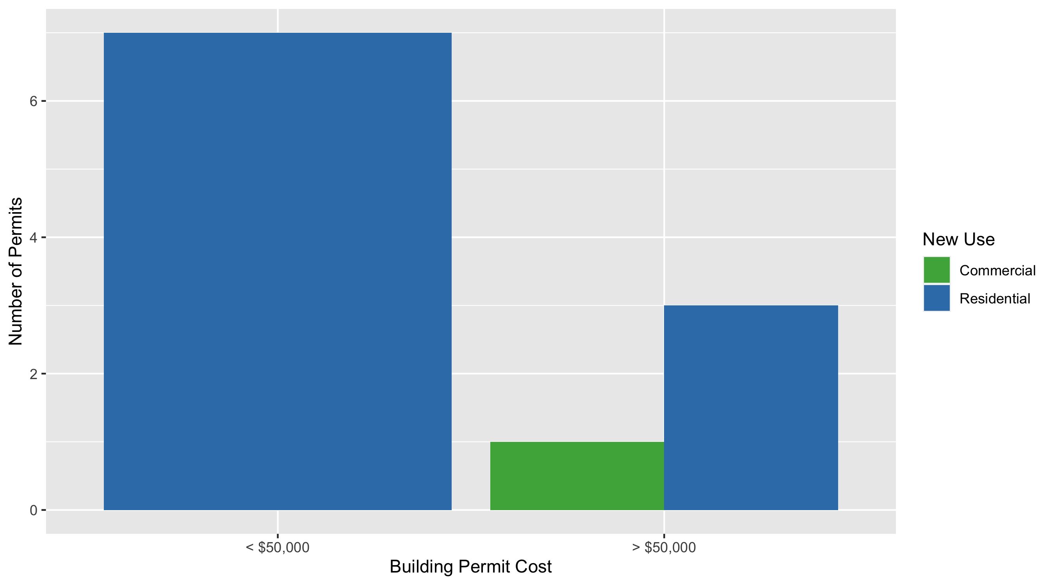
West End Permit Cost Breakdown

Slide 34
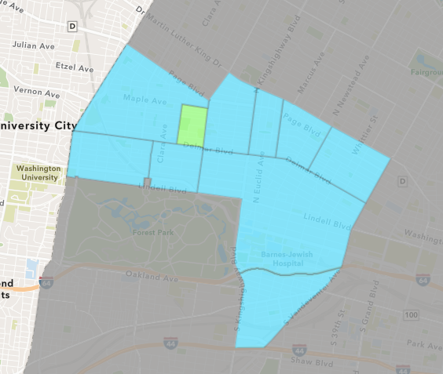
Visitation Park
November 2020 Neighborhood Cost Breakdown
Mean: $7,774
Median: $7,774
Range: $7,774 - $7,774

Slide 35
Visitation Park: Summary Notes
1 building permits in November 2020
Infinite change compared to November 2019 (0 total building permits)
$7,774: Average building permit cost in November 2020
Infinite change compared to November 2019 ($0)
7 total building permits in 2020
600.00% change YTD compared to this time in 2019 (1 total building permits)
$16,747: YTD average building permit cost in 2020
109.34% change YTD compared to this time in 2019 ($8,000)

Slide 36
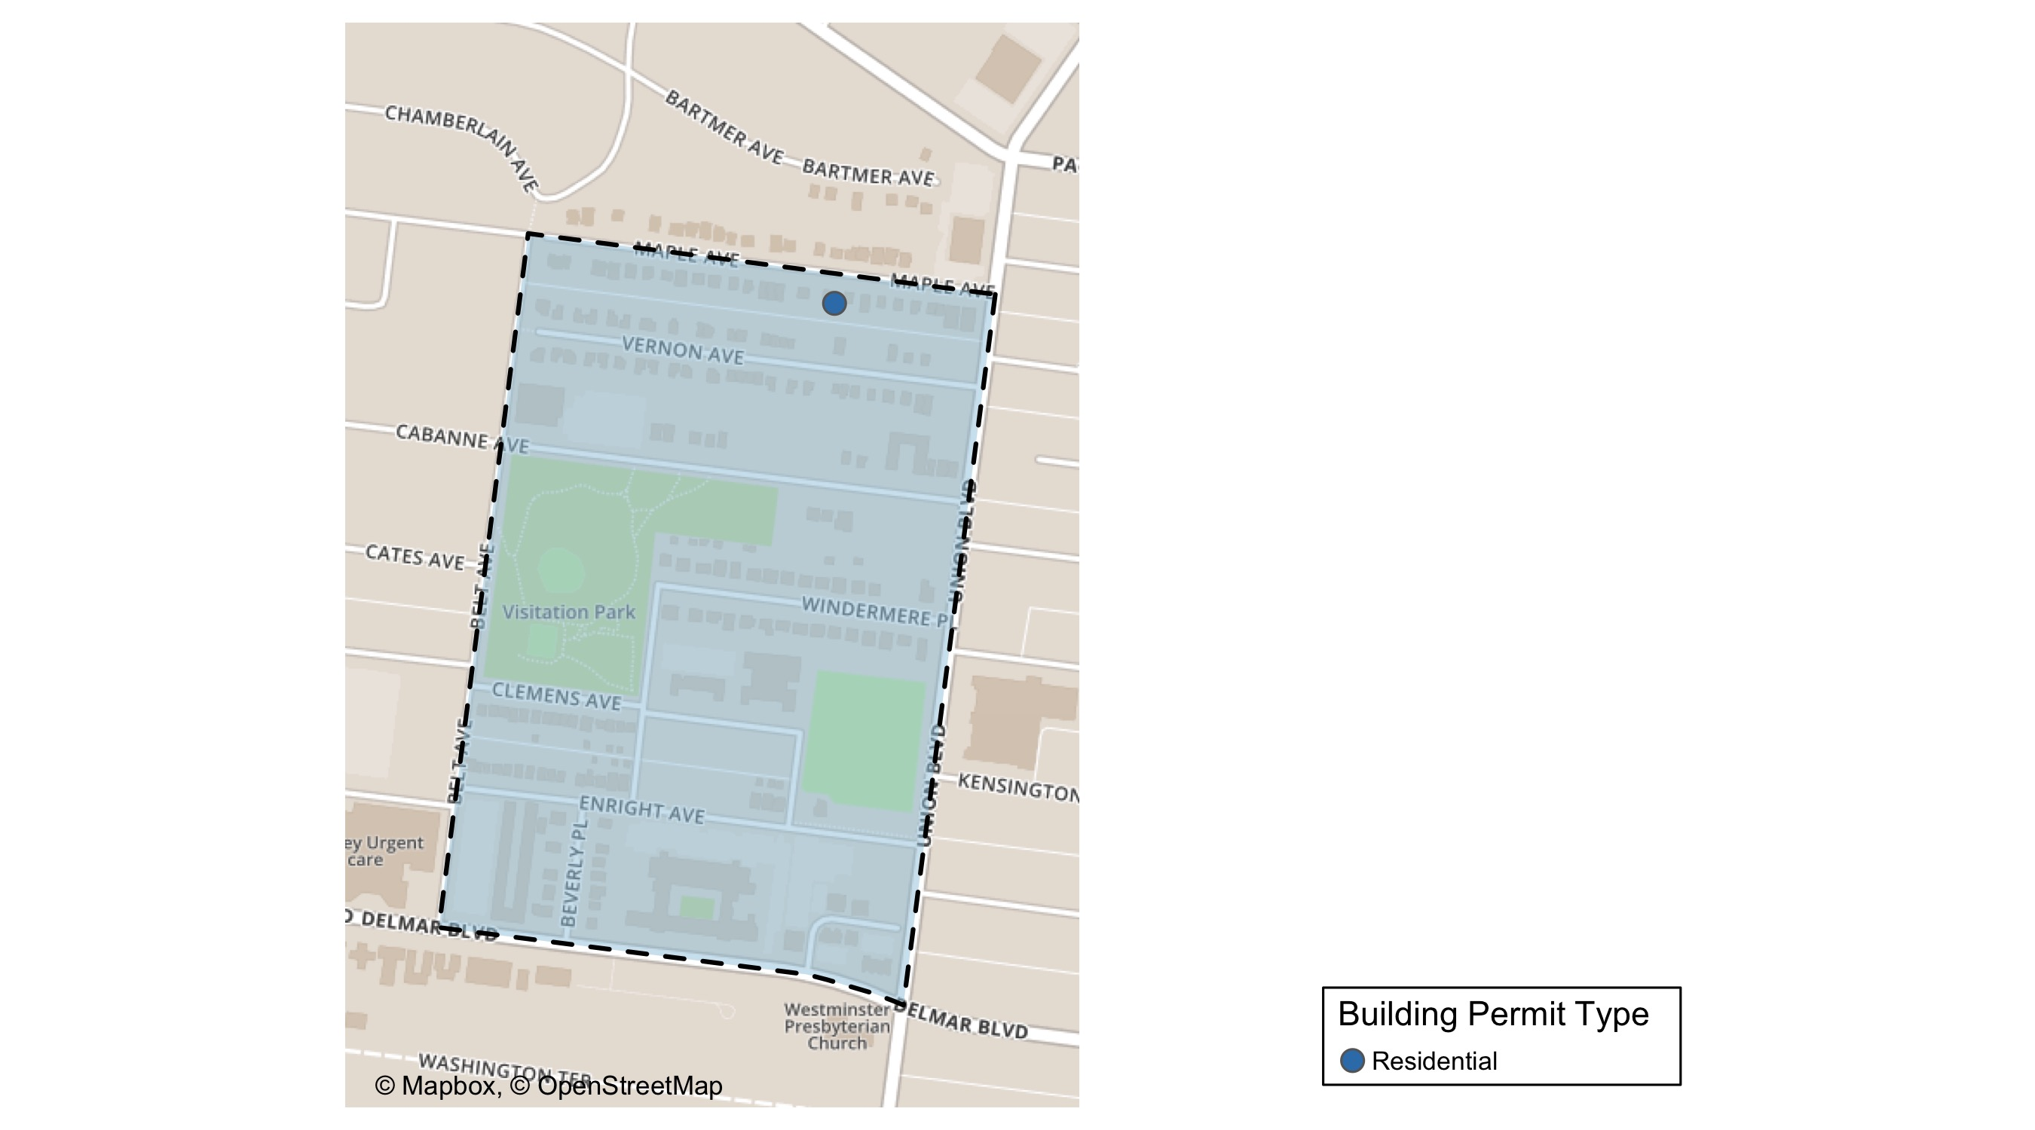
Visitation Park

Slide 37
Visitation Park
November 2020 | November 2020 | November 2020 | November 2020
Permit Use | Average Cost | # of Permits | Total Value of Permits
Commercial | $0 | 0 | $0
Industrial | $0 | 0 | $0
Institutional | $0 | 0 | $0
Residential | $7,774 | 1 | $7,774
Last 6 Months | Last 6 Months | Last 6 Months | Last 6 Months
Permit Use | Average Cost | # of Permits | Total Value of Permits
Commercial | $0 | 0 | $0
Industrial | $0 | 0 | $0
Institutional | $0 | 0 | $0
Residential | $17,205 | 6 | $103,229

Slide 38
Visitation Park Individual Permit Breakdown
Owner | New Use | Cost | Address
BUTLER, BREONA | Residential | $7,774 | 5364 MAPLE AV

Slide 39
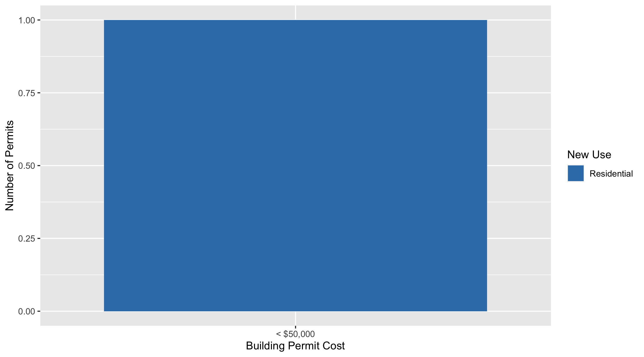
Visitation Park Permit Cost Breakdown

Slide 40
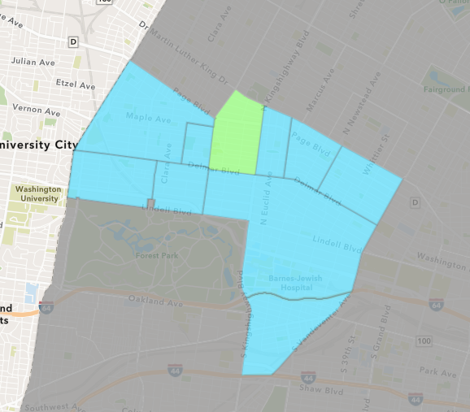
Academy
November 2020 Neighborhood Cost Breakdown
Mean: $4,644
Median: $1,434
Range: $300 - $15,000

Slide 41
Academy: Summary Notes
7 building permits in November 2020
133.33% change compared to November 2019 (3 total building permits)
$4,644: Average building permit cost in November 2020
-36.97% change compared to November 2019 ($7,368)
46 total building permits in 2020
39.39% change YTD compared to this time in 2019 (33 total building permits)
$36,376: YTD average building permit cost in 2020
-30.38% change YTD compared to this time in 2019 ($52,247)

Slide 42
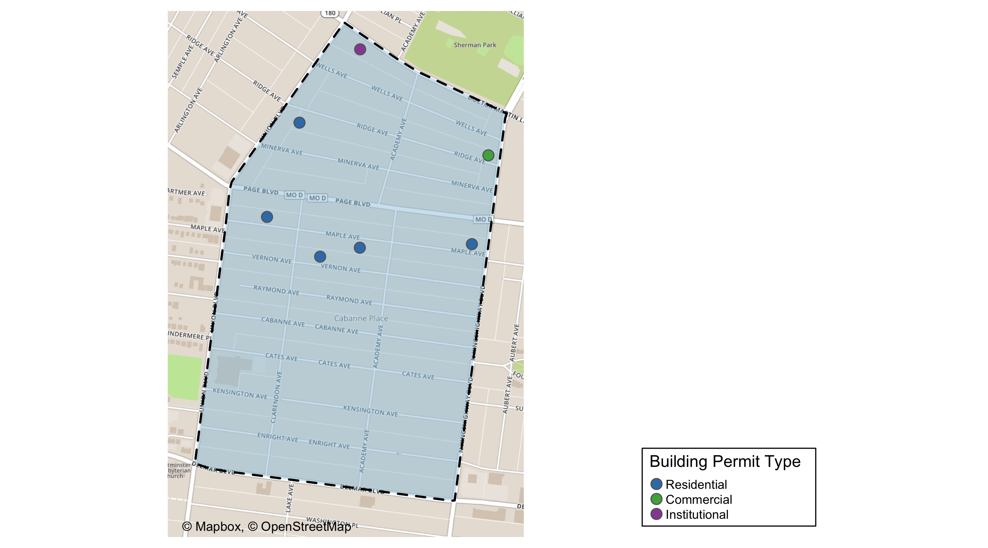
Academy

Slide 43
Academy
November 2020 | November 2020 | November 2020 | November 2020
Permit Use | Average Cost | # of Permits | Total Value of Permits
Commercial | $15,000 | 1 | $15,000
Industrial | $0 | 0 | $0
Institutional | $5,500 | 1 | $5,500
Residential | $2,402 | 5 | $12,009
Last 6 Months | Last 6 Months | Last 6 Months | Last 6 Months
Permit Use | Average Cost | # of Permits | Total Value of Permits
Commercial | $12,500 | 2 | $25,000
Industrial | $0 | 0 | $0
Institutional | $20,167 | 3 | $60,500
Residential | $19,095 | 28 | $534,669

Slide 44
Academy Individual Permit Breakdown
Owner | New Use | Cost | Address
THE SHERWIN-WILLIAMS CO | Commercial | $15,000 | 1415 N KINGSHIGHWAY BLVD
REED OWENS, LACONNIE | Residential | $1,434 | 5103 VERNON AV
MOORE, JOHNNIE E & ARVIS D | Residential | $800 | 1342 UNION BLVD
HORIZON NORTH HOUSING INC | Residential | $8,475 | 5046-48 PAGE BLVD
BURROUGHS, KRISTON & | Residential | $300 | 5182 MAPLE AV
B & H REAL ESTATE VENTURES LLC | Institutional | $5,500 | 5188 DR MARTIN LUTHER KING DR
KESMAA-SERUD, ANNSIL | Residential | $1,000 | 5225 MAPLE AV

Slide 45
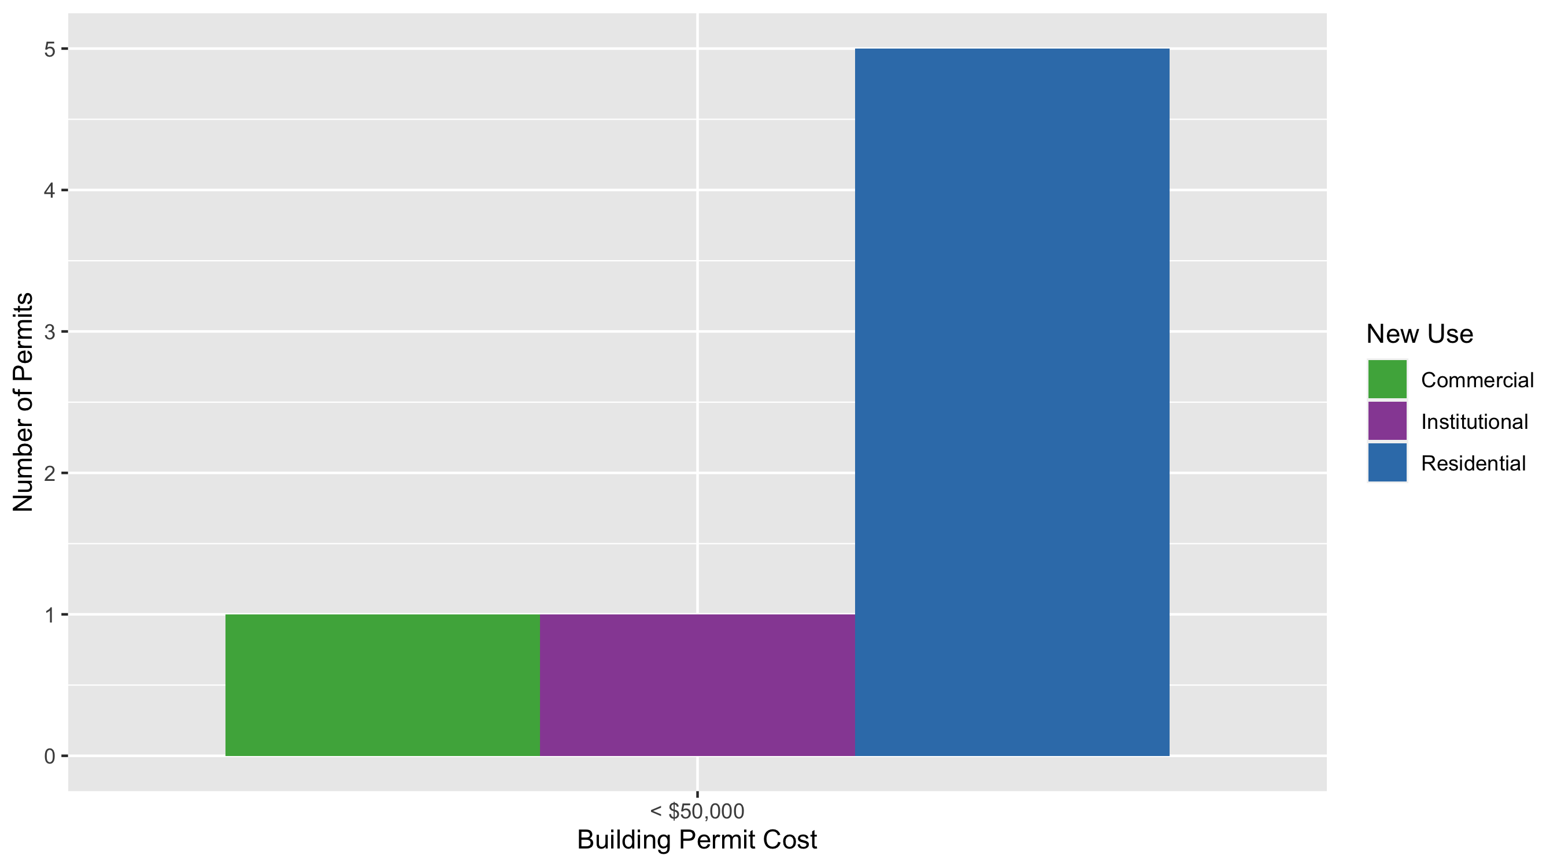
Academy Permit Cost Breakdown

Slide 46
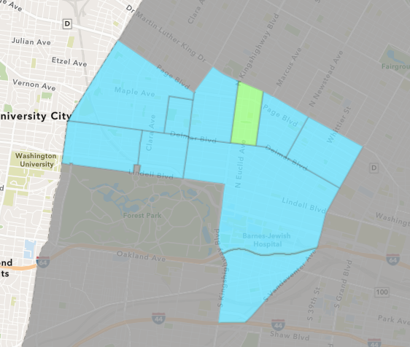
Fountain Park
November 2020 Neighborhood Cost Breakdown
Mean: $0
Median: NA
Range: $0 - $0

Slide 47
Fountain Park: Summary Notes
0 building permits in November 2020
-100.00% change compared to November 2019 (2 total building permits)
$0: Average building permit cost in November 2020
-100.00% change compared to November 2019 ($50,000)
7 total building permits in 2020
-36.36% change YTD compared to this time in 2019 (11 total building permits)
$44,786: YTD average building permit cost in 2020
25.62% change YTD compared to this time in 2019 ($35,651)

Slide 48
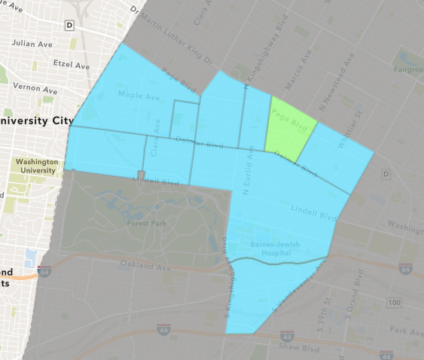
Lewis Place
November 2020 Neighborhood Cost Breakdown
Mean: $0
Median: NA
Range: $0 - $0

Slide 49
Lewis Place: Summary Notes
0 building permits in November 2020
-100.00% change compared to November 2019 (1 total building permits)
$0: Average building permit cost in November 2020
-100.00% change compared to November 2019 ($2,500)
15 total building permits in 2020
66.67% change YTD compared to this time in 2019 (9 total building permits)
$53,197: YTD average building permit cost in 2020
325.20% change YTD compared to this time in 2019 ($12,511)

Slide 50
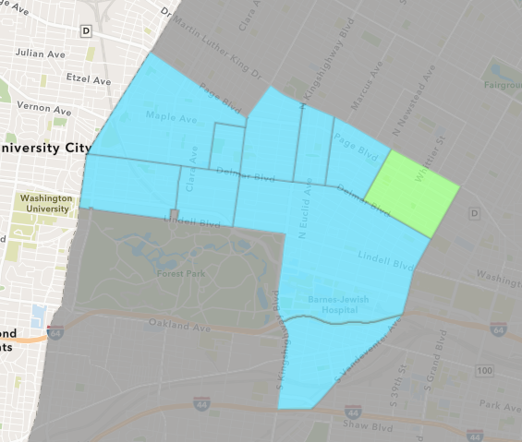
Vandeventer
November 2020 Neighborhood Cost Breakdown
Mean: $0
Median: NA
Range: $0 - $0

Slide 51
Vandeventer: Summary Notes
0 building permits in November 2020
0.00% change compared to November 2019 (0 total building permits)
$0: Average building permit cost in November 2020
0.00% change compared to November 2019 ($0)
16 total building permits in 2020
-48.39% change YTD compared to this time in 2019 (31 total building permits)
$43,503: YTD average building permit cost in 2020
-62.21% change YTD compared to this time in 2019 ($115,115)

Slide 52
Additional Notes
Data retreived from https://www.stlouis-mo.gov/data/
Building permits with a cost of $0 were dropped
Building permits that were cancelled were dropped
Infinite change indicates 0 permits in the current or previous time period/comparison month so there was a overall increase or decrease

